Slide 1


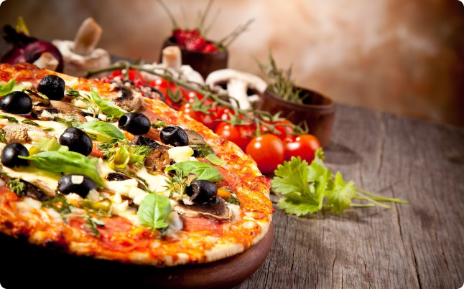

Pizza Sales Analysis
Dive into the world of pizza sales with an in-depth analysis of orders, revenue, pricing, and customer preferences. This MySQL-powered project provides valuable insights to help optimize your pizza business.
by DADASO PATIL

Slide 2

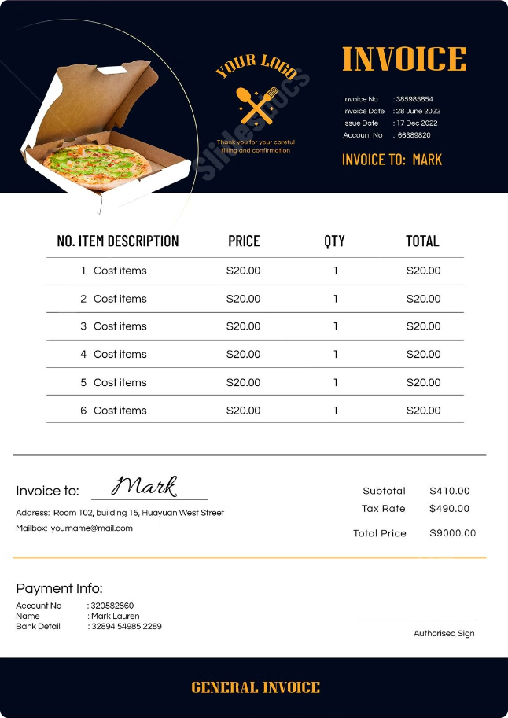
Total Number of Orders
1
Comprehensive View
2
Valuable Metric
The total number of orders placed provides a high-level understanding of the overall pizza sales activity.
This information can help identify trends, monitor growth, and make informed business decisions.
3
SQL Query
The SQL query SELECT COUNT(order_id) AS total_orders FROM orders; returns the total number of orders.

Slide 3
Total Revenue from Pizza Sales
Revenue Calculation
SQL Query
Insights
The SQL query SELECT COUNT(quantity) AS total_revenue FROM order_details; provides the total revenue from pizza sales.
Understanding the total revenue helps analyze the financial performance of the pizza business and identify areas for improvement.
To calculate the total revenue, we need to count the quantity of items ordered and multiply it by the price per item.

Slide 4


Highest Priced Pizza
Identifying Top-Tier Pizzas
SQL Query
The SQL query SELECT DISTINCT price FROM pizza ORDER BY price DESC LIMIT 1; returns the highest priced pizza.
Knowing the highest priced pizza on the menu can help understand customer preferences and pricing strategies.
Pricing Insights
This information can be used to analyze profit margins, market positioning, and potential for premium offerings.

Slide 5

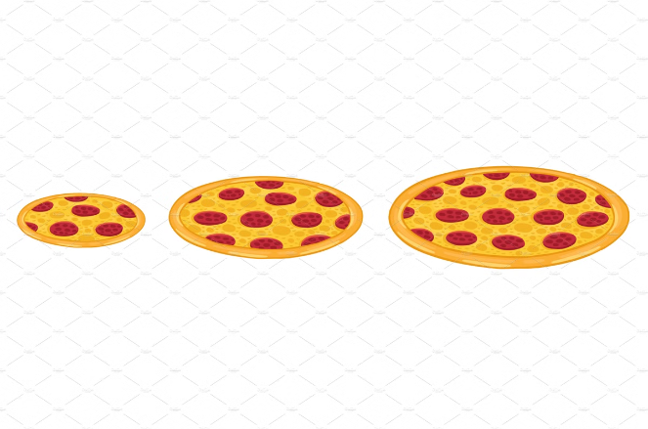
Most Common Pizza Size Ordered
1
Data Aggregation
The SQL query SELECT size, COUNT(*) AS OrderCount FROM pizza GROUP BY size ORDER BY OrderCount DESC; groups the orders by pizza size and counts the occurrences.
2
Identifying Trends
Analyzing the most common pizza size ordered provides insights into customer preferences and can guide menu optimization.
3
Business Implications
This information can help with inventory management, ingredient sourcing, and tailoring the menu to meet customer demand.

Slide 6





Optimizing Pizza Sales
Data-Driven Insights
Inventory Management
Targeted Marketing
Profitability Boost
The analysis provides valuable data-driven insights to guide business decisions and optimize pizza sales.
Understanding customer preferences and best-selling pizzas can help with efficient inventory planning and sourcing.
Tailoring the menu and promotions based on the analysis can attract more customers and increase sales.
Optimizing pricing, portion sizes, and popular items can lead to increased profitability for the pizza business.

Slide 7

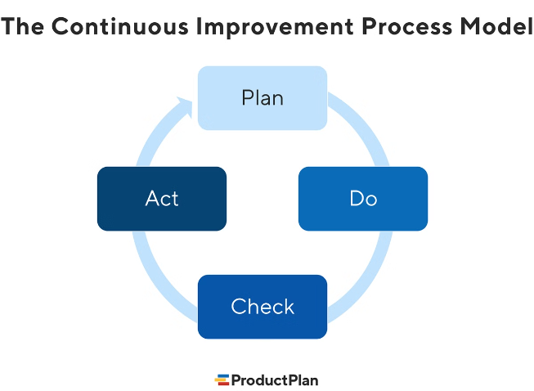



Next Steps: Continuous Improvement
Ongoing Monitoring
Regularly analyzing pizza sales data to identify trends and adapt to changing customer preferences.
Menu Optimization
Refine the menu by adding or removing items based on the insights from the analysis.
Promotional Strategies
Develop targeted marketing campaigns and promotions to drive sales of best-selling pizzas.

Slide 8

Leveraging Data for Growth
Metric
Insights
Impact
Total Orders
Understand overall sales activity
Identify growth opportunities
Total Revenue
Analyze financial performance
Optimize pricing and profitability
Highest Priced Pizza
Recognize customer preferences for premium offerings
Develop targeted marketing strategies
Most Common Pizza Size
Tailor menu to meet customer demand
Improve inventory management and supply chain

Slide 9
Empowering the Pizza Business
Informed Decision-Making
Operational Efficiency
Competitive Advantage
The insights from this analysis empower the pizza business to make data-driven decisions that align with customer preferences and drive growth.
Understanding the most popular pizzas and ordering trends enables the business to optimize inventory, streamline operations, and improve profitability.
By leveraging the analysis, the pizza business can gain a competitive edge through targeted marketing, menu optimization, and strategic pricing.

Slide 10

Conclusion: Unlocking Pizza Sales Potential
Comprehensive Insights
Actionable Strategies
Continuous Improvement
The "Pizza Sales Analysis" project provides a deep understanding of order volumes, revenue, pricing, and customer preferences.
The analysis empowers the pizza business to implement data-driven strategies for menu optimization, inventory management, and targeted marketing.
Ongoing monitoring and analysis will enable the pizza business to adapt to changing market conditions and stay ahead of the competition.

